Slide 1

INGLÉS PARA EL TRABAJO
Tema 7: There is and there are
Todas las carreras.

Slide 2
Describe un lugar formulando oraciones y preguntas utilizando there is / there are en afirmativo, negativo y yes/no questions.

Slide 3
TEMA 7: There is and There are
SUBTEMAS:
There is and there are in Affirnative, Negative and Yes/no questions .

Slide 4
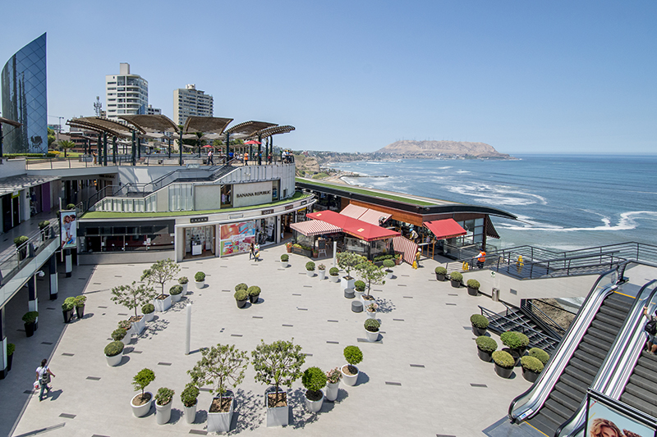
Inglés para el Trabajo
There is and there are
Look at the picture and answer:
What place is it?
What can you see?

Slide 5
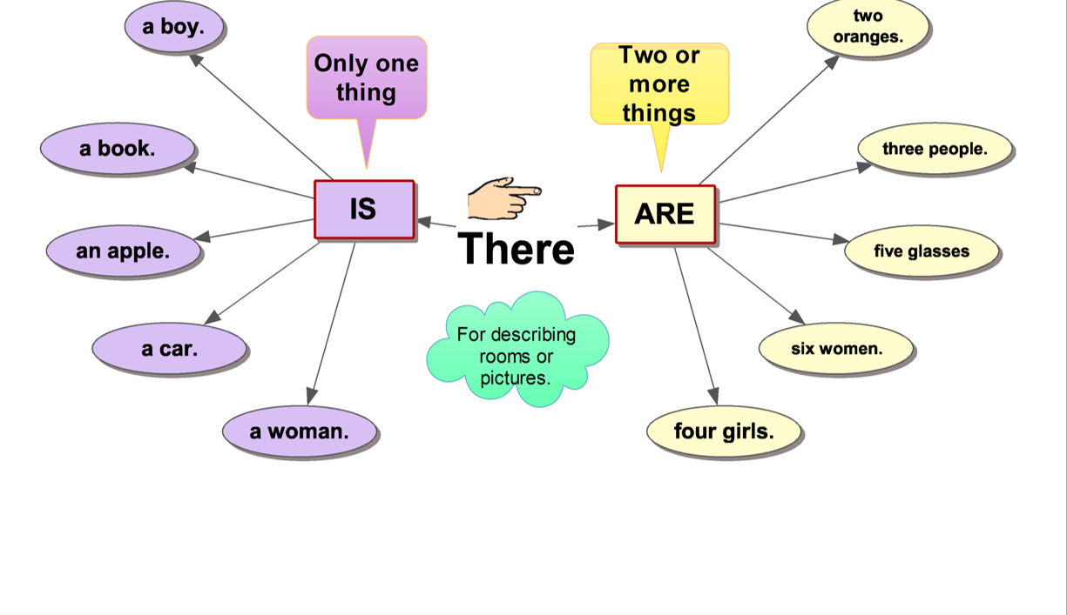

Inglés para el Trabajo
There is and there are
We use there is and there are to describe rooms or your favorite places.

Slide 6
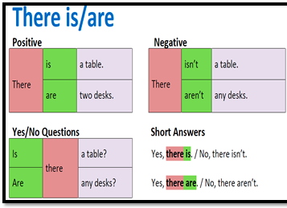
Inglés para el Trabajo
There is and there are
We use there is and there are in these forms:

Slide 7
Inglés para el Trabajo
There is and there are
We use there is and there are in this form:

Slide 8
Virtual Activity

Slide 9
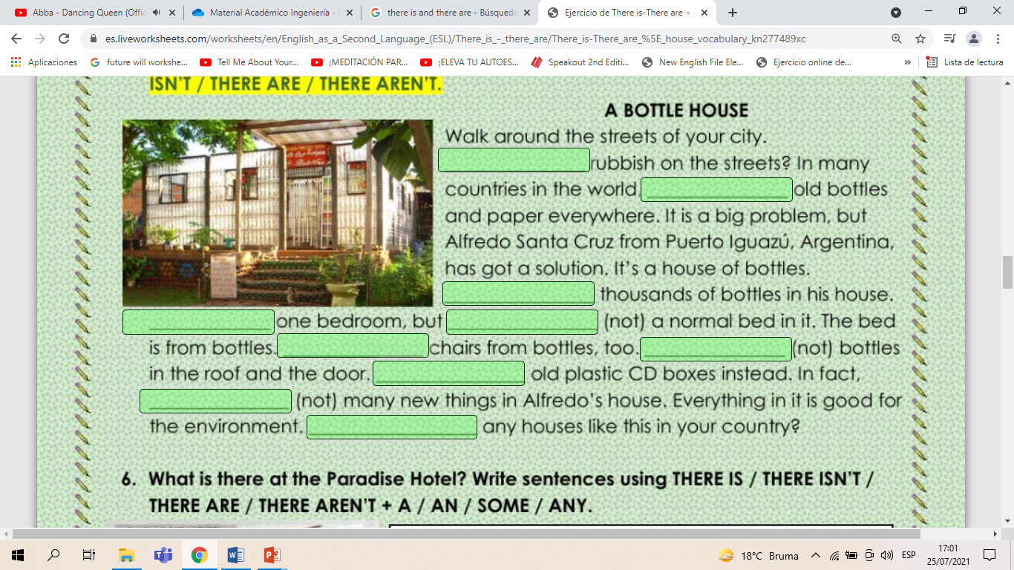
Inglés para el Trabajo
Virtual Activity
Read and complete this text with there is ,there are, there isn’t and there aren’t.

Slide 10
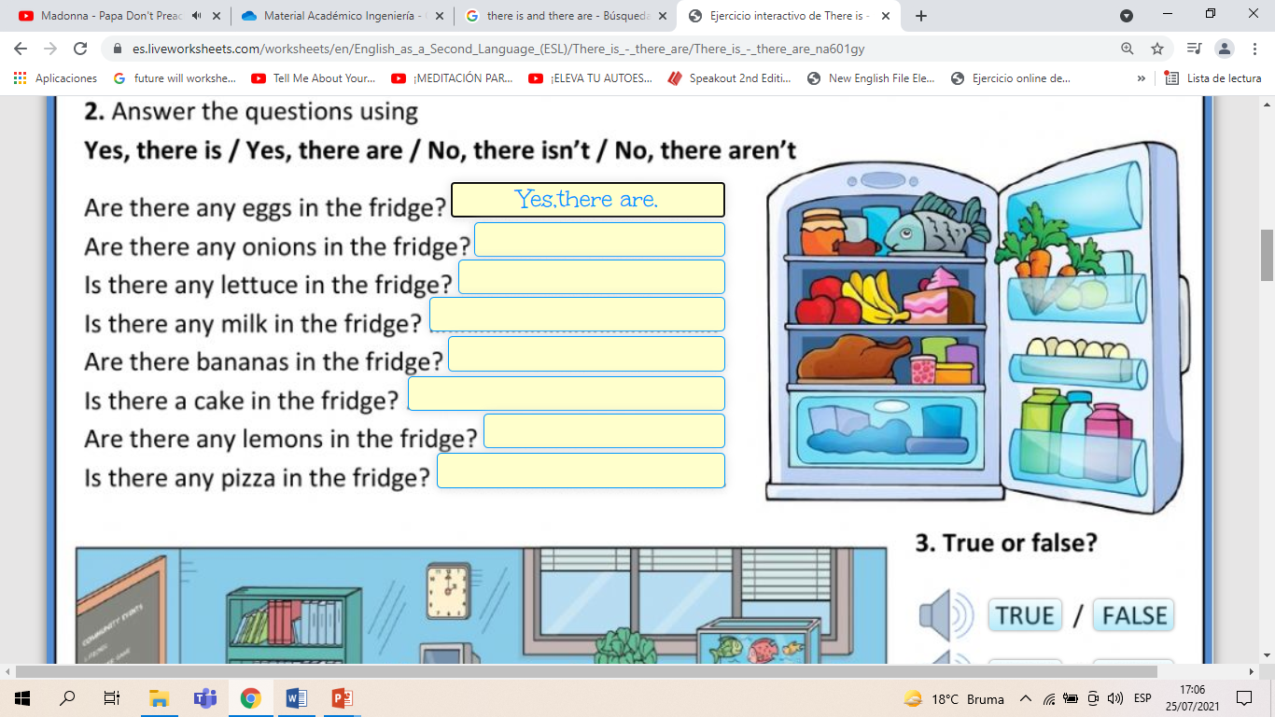
Inglés para el Trabajo
Virtual Activity
Look,read and answer with Yes,there is /Yes,there are or No,there isn’t /No,there aren’t.

Slide 11
Thanks!

